Slide 1


Stance Detection System for Combating Fake News:
An AI-Powered Solution for Accurate News Classification
Group 24
Group Member: Lu Mingrui
Student ID: A0307208L

Slide 2
Table of Contents
1
Business Pain
2
Existing Solutions & Market Landscape
3
Why Our Solution is Better
4
Use Case Demo
5
Conclusion

Slide 3

Business Pain - The Growing Problem of Fake News

Slide 4

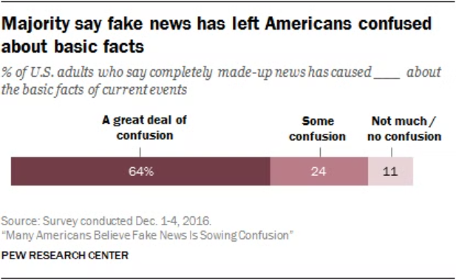
The Challenge of Fake News
Misinformation spreads quickly and harms public trust.
Manual fact-checking is time-consuming and prone to error.
Need for scalable, real-time solutions to handle large volumes of data.
" False news stories are 70% more likely to be retweeted than true stories (2018 MIT study)."

Slide 5

Existing Solutions & Market Landscape
Fact-checking tools like Factmata, FactCheck.org heavily rely on manual verification.
AI tools are emerging but lack scalability and accuracy.
Many solutions are limited in handling nuanced content relationships.

Slide 6

Why Our Solution is Better?

Slide 7

Why Choose Our System?
Automates the detection of misleading or false information.
Uses advanced AI models: SVM, XGBoost, CatBoost, LightGBM, and BERT.
High accuracy with real-time performance.
Handles complex stance classification: agrees, disagrees, discusses, unrelated.
Processes large volumes of data quickly and reliably.
Reduces human error and manual fact-checking workload.
Scalable for media platforms, fact-checking agencies, and social media platforms.

Slide 8
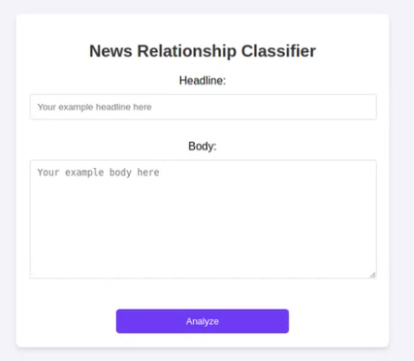
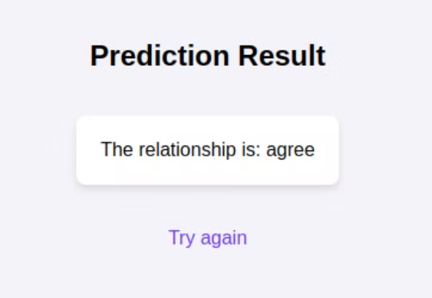
Use Case Demo
Input: Headline and body text.
Output: Stance classification – agrees, disagrees, discusses, or unrelated.
Real-time results.

Slide 9
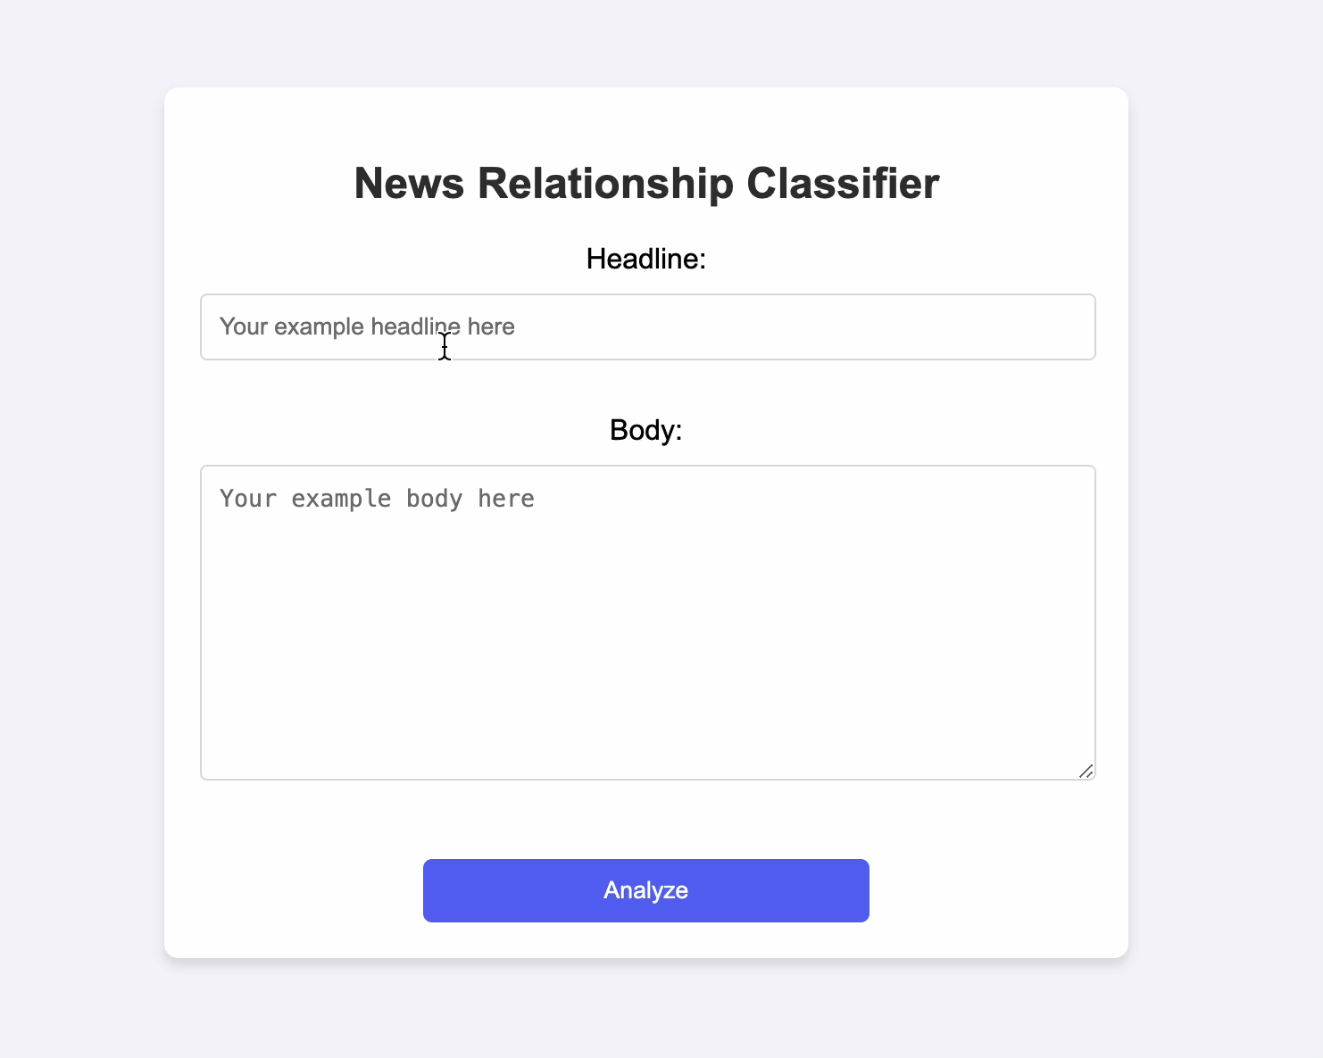
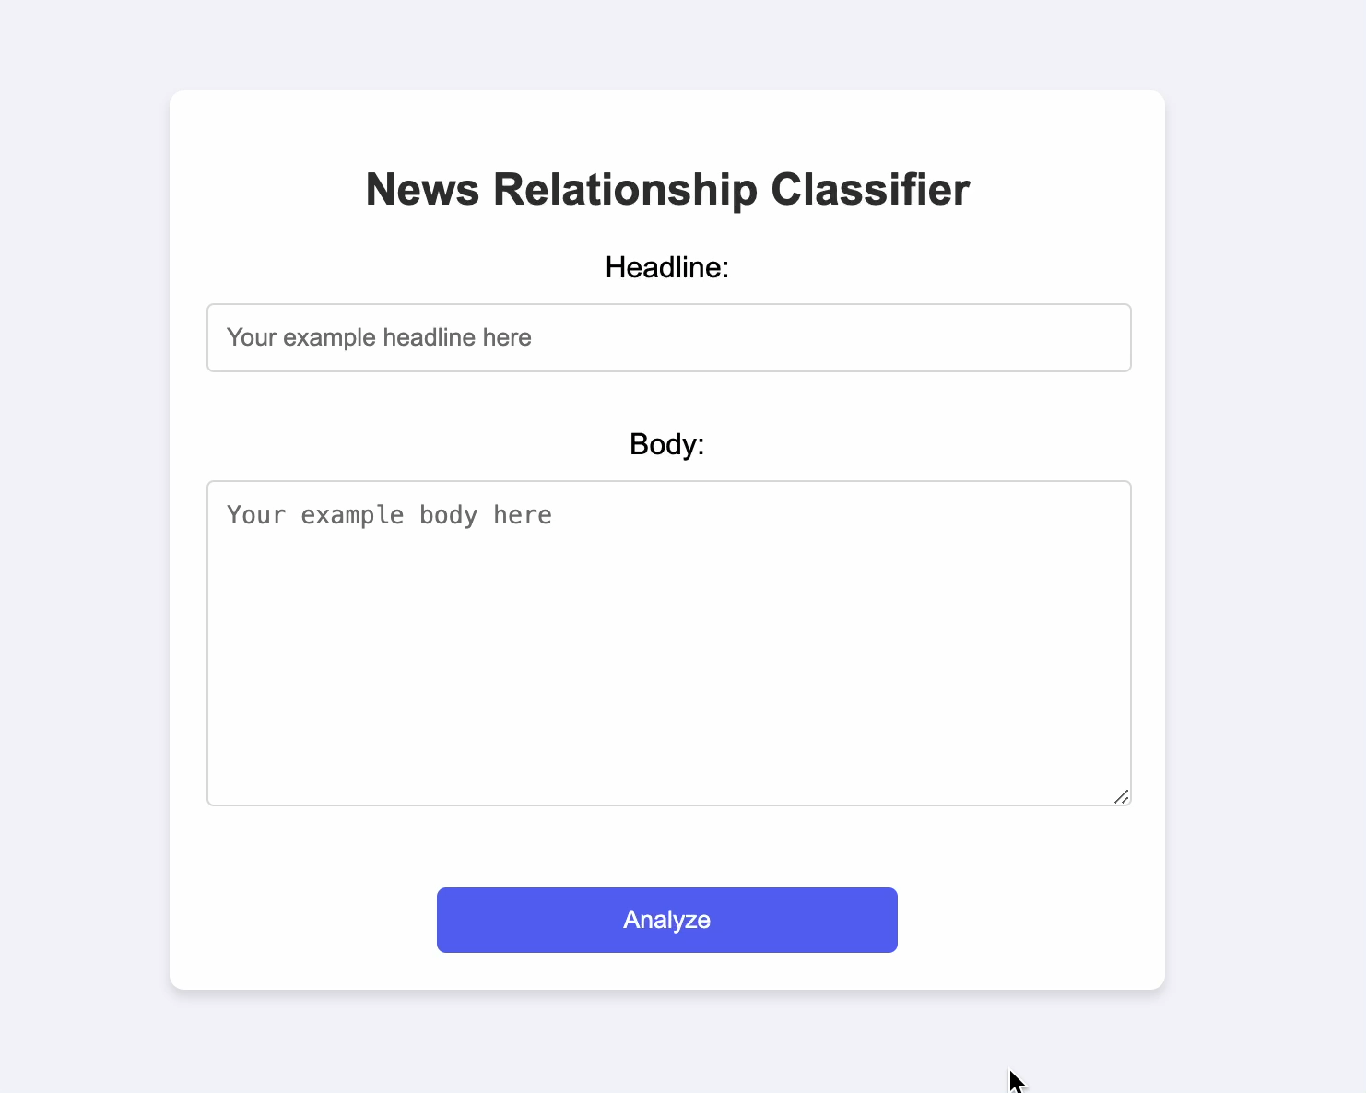
Use Case Demo
Unrelated case
Disagree case

Slide 10

Competitive Advantage - What Makes Us Different?
Combines the latest in machine learning and deep learning technologies.
Real-time processing of large datasets.
Reduces human error and manual fact-checking workload.
Easy integration with media platforms and scalable for various industries.
Outperforms existing systems in both speed and accuracy.

Slide 11

Conclusion
Successfully developed an advanced AI-powered stance detection system.
Utilizes models like SVM, XGBoost, and BERT for high accuracy and reliability.
Scalable and real-time solution for media platforms and capable of processing large data volumes with precision.
Ready to make a significant impact in the fake news detection market.

Slide 12
THANK YOU!

